Slide 1

Crafting Compelling Web Presences
Project Report on the services of Tata Consultancy Services
by Udbhav Singh

Slide 2
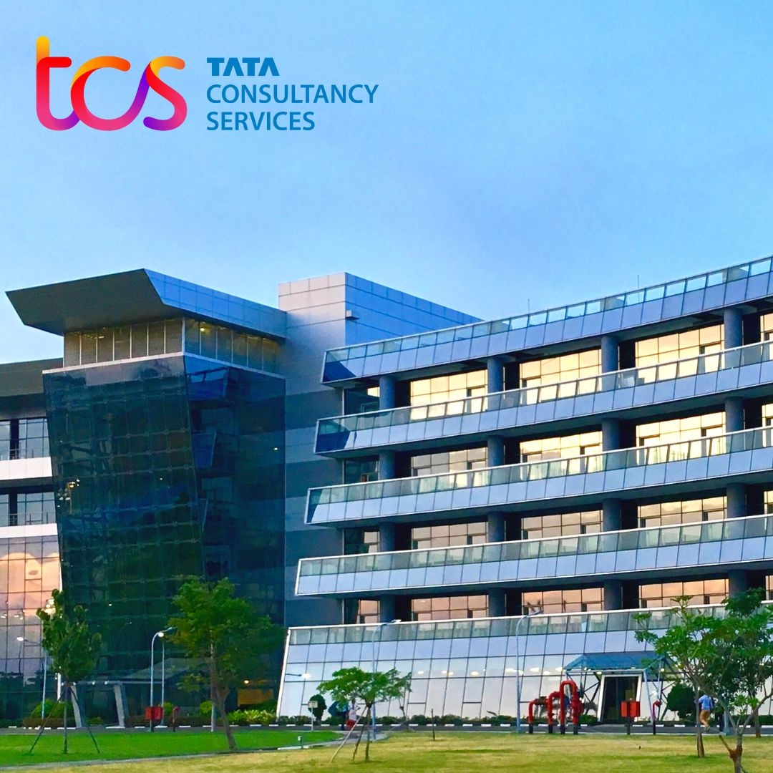
Introduction of Tata Consultancy Services
Tata Consultancy Services (TCS) is a leading global IT services, consulting, and business solutions organization. Founded in 1968 and headquartered in Mumbai, India, TCS has a strong presence in over 46 countries, boasting a workforce of over 600,000 employees. As the largest IT services company in India and among the largest globally, TCS has established itself as a key player in the IT industry.

Slide 3
Compelling Presence of Tata Consultancy Services in the World of Web
User-Friendly Website
Well-Designed Interface
TCS recognizes the significance of web presence in the digital era. Their user-friendly and informative website showcases a wide array of services and solutions. The website is available in multiple languages to cater to a diverse global audience, demonstrating TCS's commitment to inclusivity and accessibility.
The TCS website is well-designed and easy to navigate, providing a valuable resource for potential clients and partners. The modern, professional interface reflects TCS's commitment to excellence and attention to detail.

Slide 4
Understanding the Products or Services of TCS
1
Wide Range of Offerings
2
Core Offerings
TCS offers an extensive array of products and services tailored to various industries.
Some key areas include IT consulting, IT services, business process outsourcing (BPO), cloud computing, big data analytics, cybersecurity, and software development.
3
Industry Focus
4
Digital Transformation Enabler
TCS caters to diverse sectors like Banking, Financial Services & Insurance (BFSI), telecommunications, healthcare, manufacturing, retail, and more.
Their solutions help businesses leverage digital technologies to improve efficiency, reduce costs, and gain a competitive edge.

Slide 5

TCS ION TM
Technology Driven Education Solutions
Strategic unit of Tata Consultancy Services (TCS): Focuses on learning, assessments, and business processes.
Empowering People and Organizations: Uses technology-driven education to transform individuals and businesses for the modern world.
Solutions for Various Stakeholders: Offers interventions for recruitment boards, corporations, educational institutions, and individual learners.
Range of Services: Includes course delivery, assessments, skill development programs, and more.

Slide 6


TCS BaNCS TM
Insurance Industry Solutions
TCS BaNCS is a comprehensive suite of solutions for the core insurance industry.
TCS BaNCS helps insurers with everything from policy administration and claims processing to underwriting and risk management.
This platform can help insurers improve their operational efficiency, reduce costs, and provide a better experience for their customers.

Slide 7

TCS ignio TM
Cognitive Automation
TCS ignio is a cognitive automation platform that helps businesses automate routine tasks and processes.
TCS ignio uses artificial intelligence (AI) and machine learning (ML) to identify opportunities for automation and then develop and deploy automated solutions
This platform can help businesses improve their efficiency, reduce costs, and free up their employees to focus on more strategic work.

Slide 8
Platforms on which TCS website has been designed
User-Friendly Website
Content Management System (CMS): Adobe Experience Manager (AEM) is a powerful enterprise CMS used for building websites and mobile apps. AEM offers features like:
Drag-and-Drop Editing: Allows for easy content creation and management without needing to write code.
Omnichannel Delivery: Enables consistent content delivery across various devices and platforms.
Personalization: Helps tailor website content to individual users for a more engaging experience.
Scalability: Can handle large amounts of traffic and complex websites.
Security: Provides robust security features to protect website content.
Additional Notes:
AEM is a paid enterprise solution typically used by large organizations.
TCS likely uses additional tools and integrations within the AEM platform for specific functionalities.

Slide 9
Platforms on which TCS website has been designed
Analytics and Tracking
Analytics: Adobe Analytics provides marketing analytics to measure website traffic and user behavior.
Tag Management: Adobe Launch manages various website tags and pixels from different marketing and analytics tools.
A/B Testing: Tools like Adobe Target are used to run A/B tests and optimize website content for better conversions

Slide 10
Platforms on which TCS website has been designed
Additional Technology
Marketing Automation: Adobe Marketing Cloud offers a suite of marketing automation tools for email marketing, lead nurturing, and campaign management.
Content Delivery Network (CDN): Akamai is likely used as a CDN to deliver website content efficiently around the world.
Security: Entrust SSL certificates provide website security and encrypt communication between browser and server.
Mobile Compatibility: The website uses responsive design to ensure a good user experience on mobile devices.

Slide 11
Platforms on which TCS website has been designed
Focus on User Experience
Other technologies used to enhance user experience like:
JavaScript Libraries (e.g., jQuery): Used for interactive elements and dynamic content.
Web Fonts: Ensure consistent and visually appealing fonts across devices.
Social Media Integration: Allow users to share content on social media platforms.

Slide 12
Website’s Responsive Design and mobile optimization
Here are a few points on the TCS website responsive design and mobile optimization:
Responsive Design: The TCS website likely uses responsive design principles to ensure it adapts to different screen sizes and devices (desktops, tablets, smartphones).
Viewport Meta Tag: This tag helps the website adjust its layout based on the size and resolution of the device screen.
Mobile Compatibility: Code is likely included to specifically support iPhone and mobile content in general.
User Experience (UX) Optimization: The mobile experience is likely optimized for easy navigation, touch interactions, and faster loading times. This may involve:
Larger buttons and menus for easier tapping.
Simplified layouts to avoid clutter on smaller screens.
Optimized images and videos for faster loading on mobile networks.
**The screenshots for the website design and mobile optimization are mentioned in the next slide.

Slide 13
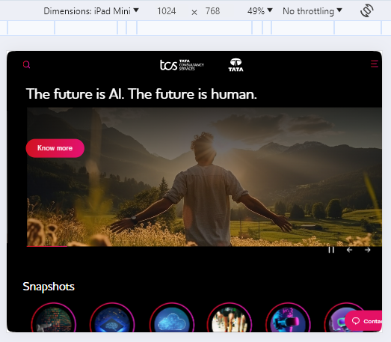
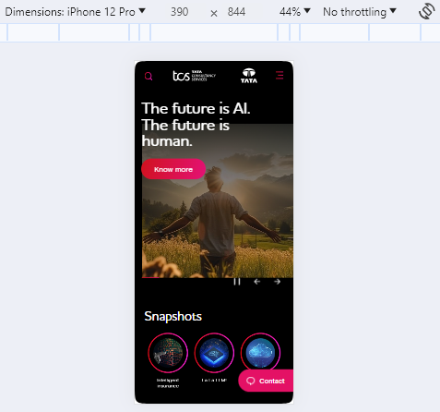
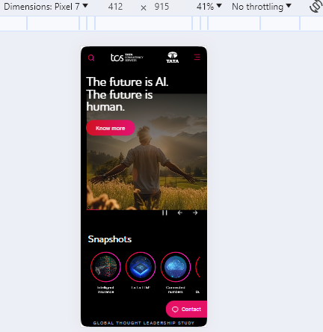
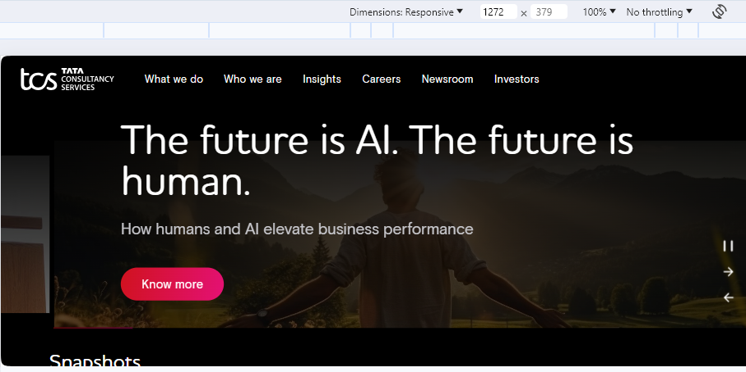
TCS Website’s Responsive Design and mobile optimization

Slide 14
Common Website Design Mistakes to Avoid **This is in comparison of the websites – www.tcs.com and www.ultimatix.net(tcs employee site)
Cluttered Layouts
Slow Loading Times
Unclear Navigation
Avoid overwhelming visitors with excessive content or complex navigation, making it challenging for them to access desired information.
Provide clear and easy-to-understand navigation for swift access to relevant information.
1
2
Engage visitors by ensuring quick loading times. Delays in loading can lead to lost opportunities.
3
4
Poor mobile responsiveness
5
Unusable fonts
In today's mobile-first world, it is important to ensure that your website is responsive and looks good on all devices.
Fonts should be easy to read and appropriate for the website's content.

Slide 15

Best Practices for Creating Visually Appealing and User-Friendly Website Designs
1
Focus on user experience (UX)
2
Use high-quality visuals
Focus on crafting a website that is easy to navigate, use, and understand. Prioritize the user experience to ensure satisfaction and engagement.
Integrate images and videos to enhance visual appeal and provide an immersive experience for visitors.
3
Keep it simple
4
Use white space effectively:
Avoid using too many colors, fonts, or graphics. The website should be clean and uncluttered.
White space can help to improve readability and make the website feel less cluttered.

Slide 16
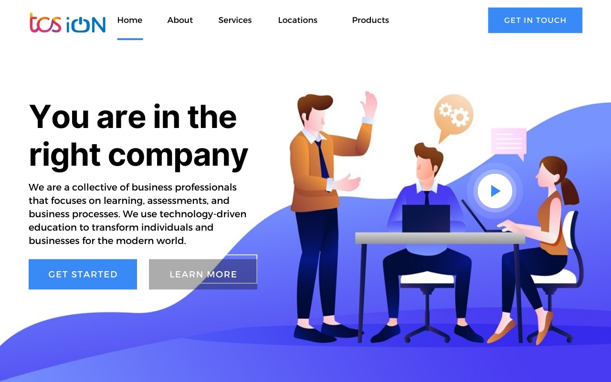
Landing zone Page screenshots for TCS ION
**Landing zone Page has been created with the help of Canva

Slide 17
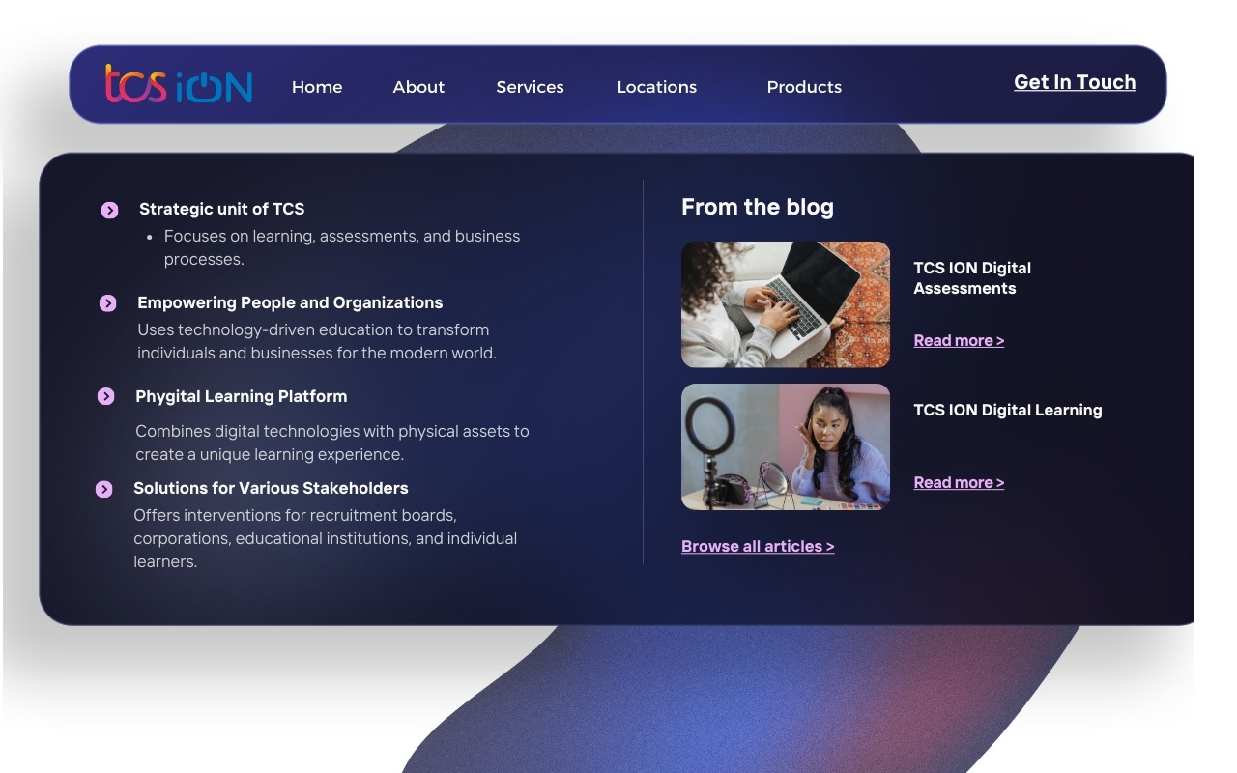
Landing zone Page screenshots for TCS ION
**Landing zone Page has been created with the help of Canva

Slide 18
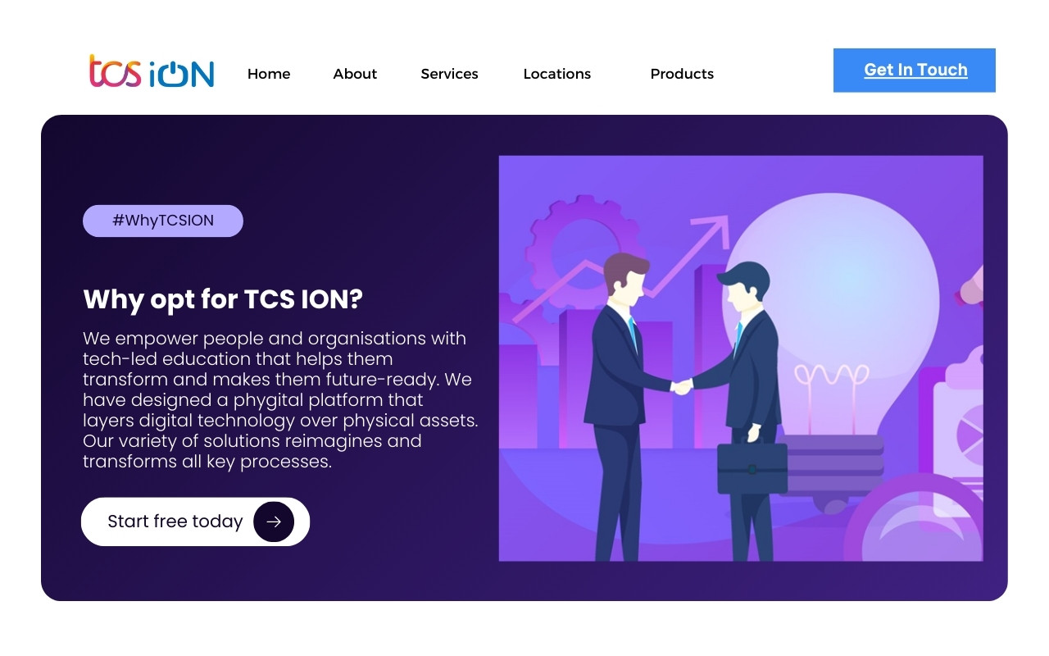
Landing zone Page screenshots for TCS ION
**Landing zone Page has been created with the help of Canva

Slide 19
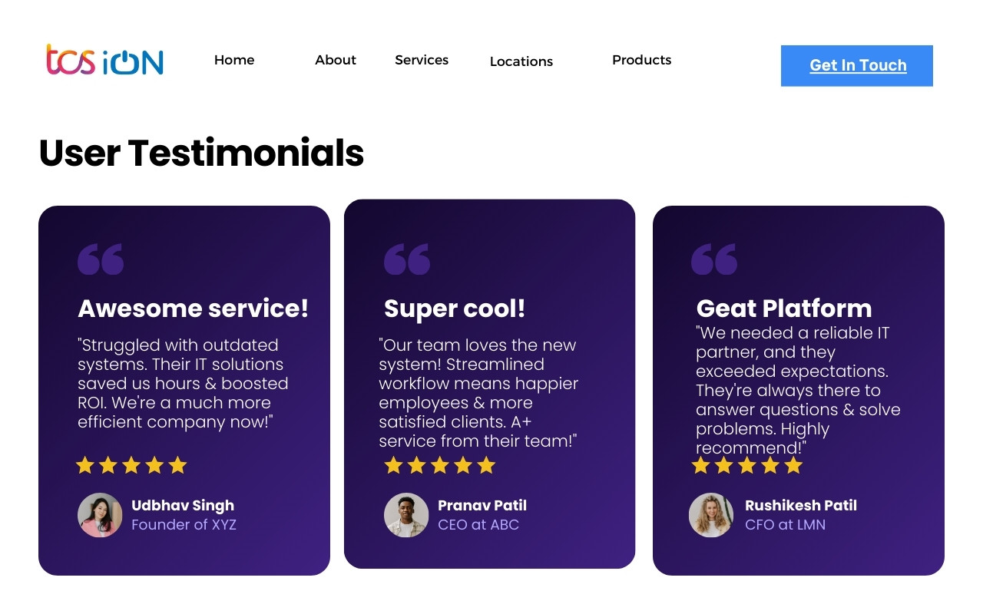
Landing zone Page screenshots for TCS ION
**Landing zone Page has been created with the help of Canva

Slide 20
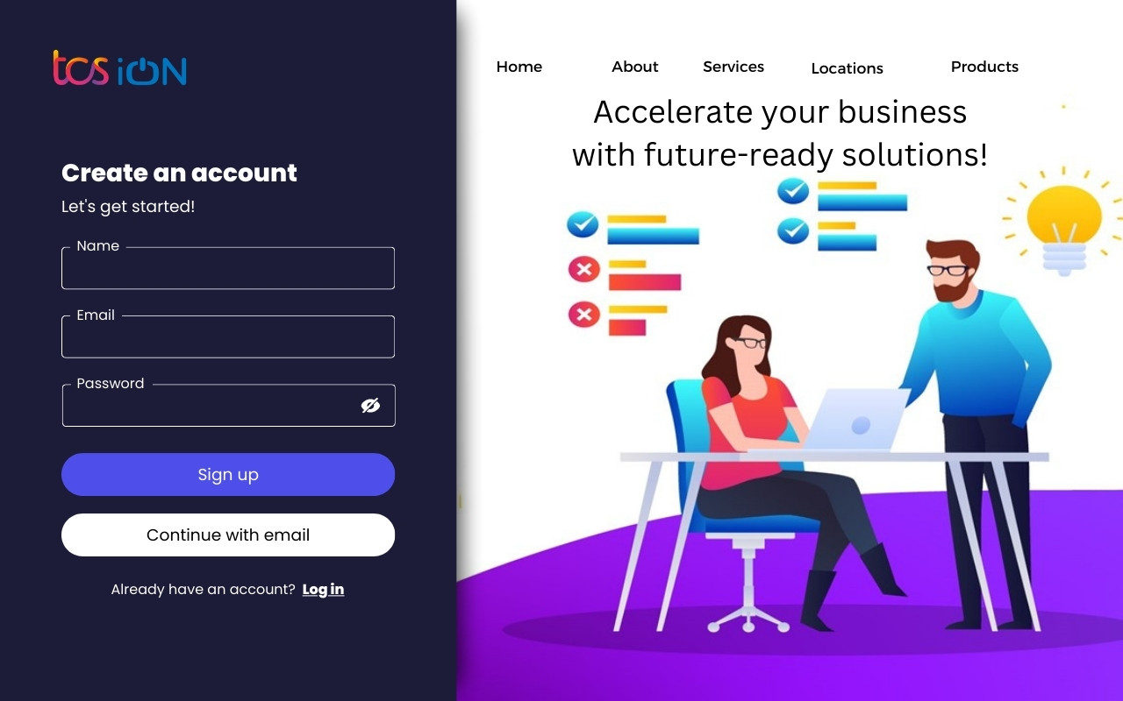
Landing zone Page screenshots for TCS ION
**Landing zone Page has been created with the help of Canva

Slide 21


